Slide 1
Focus on Children - a gradual shift towards a more child-inclusive mediation approach in family disputes
Julia Radanova, attorney-at-law and mediator, lecturer at the University of National and World Economy (Bulgaria)

Slide 2
Family mediation
process in which those involved in family breakdown, whether or not they are a couple or other family members, appoint an impartial third person to assist them to communicate better and reach their own agreed and informed decisions concerning some, or all, of the issues relating to separation, divorce, children, finance or property by negotiation
family conflict

Slide 3
Family Mediation process
Fact-finding process
Outlining agreed points
Identifying problematic issues
Exploration procedure
All the facts relevant to and revealing the interest of the participants in the conflict must be clarified and systematized
Non-conflicting points
Outlining the points on which there is no conflict;
Paraphrasing the expressed positions in a neutral way and agreeable way
Conflicting points
Outlining the issues on which the parties share a different understanding
Summarizing them in a neutral manner

Slide 4
Family Mediation process
Interests
Set of potential solutions
Settlement
Defining interests
Determining the interests of the direct participants in the conflict and of those affected by conflict
Coinciding those interests with the best interest of the child (if any)
Brainstorming
Generation of possible solutions;
Common assessment of the proposals made in light of the outlines interests
Adopting an agreeable solution
Choosing an option deemed equally acceptable by both parties
Defining parties’ commitment to its implementation

Slide 5
ENHANCEMENT TOOLS
§ Involvement and private meeting with the child as part of the mediation process, within which the same rules of confidentiality and neutrality apply;
§ Detailed and in-depth study of the interests of each parent and determination of their degree of polarization;
§ Providing or directing additional therapies or preparatory courses required by the parties before the formal initiation of a mediation procedure to establish a form of shared parenting;

Slide 6
ENHANCEMENT TOOLS
§ Deferring the parents’ focus on their principle assertions, usually based on a given theoretical statement, and directing them to the specificity of the actual needs of their children;
§ Enhanced use of the mediation reality test technique on the basis of which an objective assessment of the different options for finding a solution between the parties generated in the process is given.

Slide 7
The aim of family mediation when a relationship is broken
COMMUNICATION
DECISIONS
Stress
Relationship
Abuse
Children
Costs
Minimises stress
Promotes a good relationship
Diminish risk
Best interest
Optimize

Slide 8
Impact
max empowerment
reach decisions
improve communication
reduce intensity of dispute

Slide 9
Focus on Children project
piloting project in Bulgaria seeking to promote the new model of family-led mediation and to study the results from its application

Slide 10
Interdisciplinary approach to family conflicts with interactive involvement of children

Slide 11
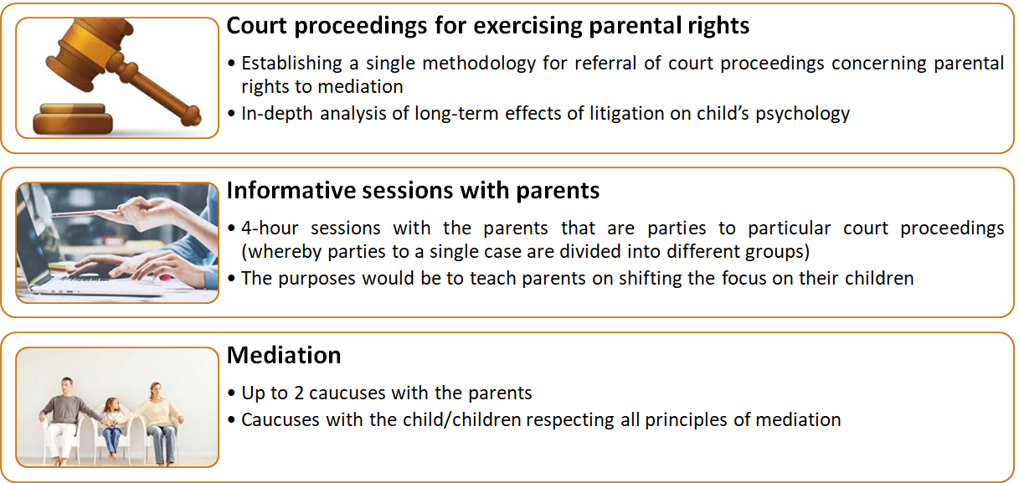

Slide 12
Institute for mediation and conflict management
M +359 887 887 621
A 56 Alabin str., fl. 5, office 5, Sofia 1000
E radanova@imeus.bg

